Slide 1
Sexual Disorders
Francis Muvea

Slide 2
Topic Outline
Sexual Disorders
I. Sexual Norms and Behavior
II. Sexual Dysfunctions
III. The Paraphilias

Slide 3
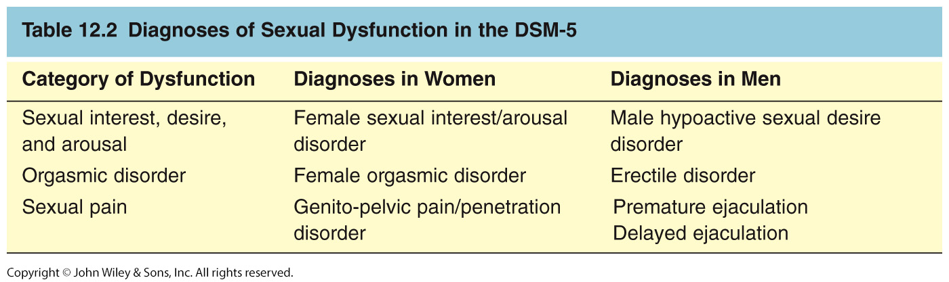
DSM-5 Sexual Dysfunction

Slide 4
Sexual Norms and Behavior
Culture influences beliefs about sexuality
Pleasure vs. procreation
Acceptable sexual behaviors vary with times and culture

Slide 5
Gender and Sexuality
Men
Think more about sex and want more sex
Masturbate more
Want more and have more partners
Consistency across cultures
Have more sexual dysfunction as they age

Slide 6
Gender and Sexuality Cont’d…
Women
Desire for sex more often linked to relationship status and social norms
Tend to be more ashamed of appearance flaws
May interfere with sexual satisfaction
At all ages, women more likely than men to report sexual dysfunction

Slide 7
The Sexual Response Cycle
Desire phase
Excitement phase
Orgasm phase
Resolution phase

Slide 8
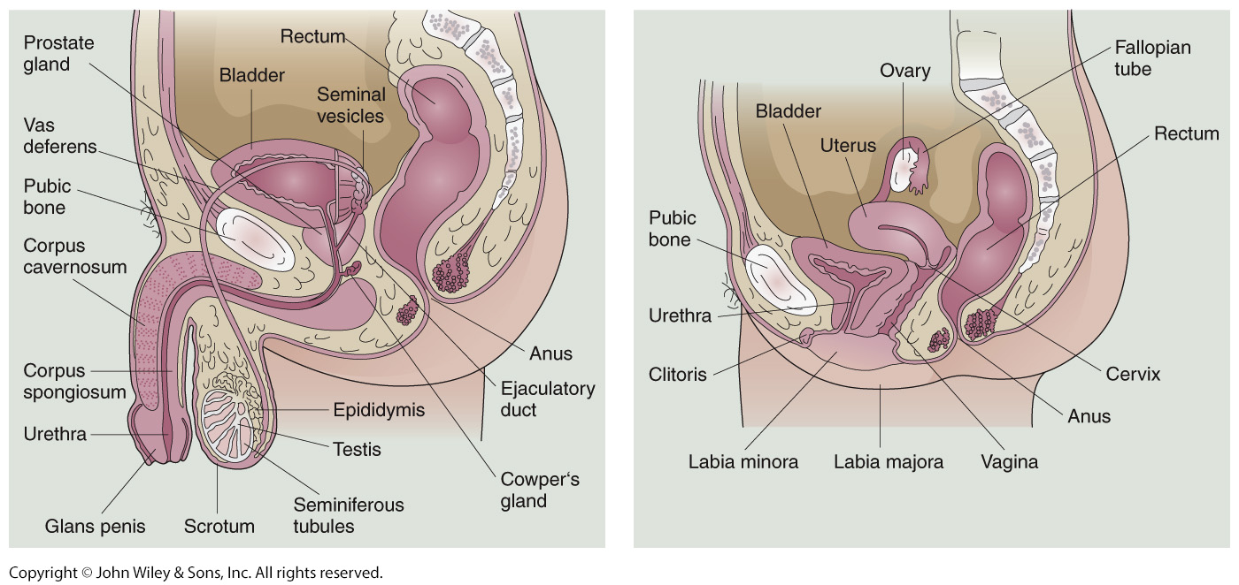
Male and Female Sexual Anatomy

Slide 9
Sexual Dysfunctions
DSM-5 has three categories of sexual dysfunction:
Sexual desire, arousal, and interest disorders
In women: Sexual interest/arousal disorder
In men: Male hyposexual disorder and Erectile disorder

Slide 10
Sexual Dysfunctions Cont’d…
Orgasmic disorders
In women: Female orgasmic disorder
In men: Premature ejaculation and delayed ejaculation

Slide 11
Sexual Dysfunctions Cont’d…
Sexual pain disorders
In women: Genito-pelvic pain/penetration disorder

Slide 12
Disorders Involving Sexual Interest, Desire, and Arousal
Sexual interest/arousal disorder in women
Persistent deficits in sexual interest (fantasies or urges), biological arousal, or subjective arousal
Hypoactive sexual desire disorder in men
Deficient or absent sexual fantasies and urges
Male erectile disorder
Failure to attain or maintain an erection of penis

Slide 13
DSM-5 Criteria for Sexual Interest/Arousal Disorder in Women
DSM-5 Criteria for Sexual Interest/Arousal Disorder in Women:
Diminished, absent, or reduced frequency of at least three of the following for 6 months or more:
Interest in sexual activity
Sexual/erotic thoughts or fantasies
Initiation of sexual activity and responsiveness to partner’s attempts to initiate

Slide 14
Cont’d…
Sexual excitement/pleasure during 75% sexual encounters
Sexual interest/arousal elicited by any internal or external erotic cues
Genital or non-genital sensations during 75% sexual encounters
Causes marked distress or interpersonal problems
Not due to a medical illness, another psychological disorder (except another sexual dysfunction), or the effects of a drug

Slide 15
DSM-5 Criteria for Male Disorders
DSM-5 Criteria for Hypoactive Sexual Desire Disorder in Men:
Sexual fantasies and desires, as judged by the clinician, are deficient or absent
Causes marked distress or interpersonal problems
Not due to a medical illness, another psychological disorder (except another sexual dysfunction), or the effects of a drug

Slide 16
DSM-5 Criteria for Male Disorders Cont’d…
DSM-5 Criteria for Male Erectile Disorder:
On at least 75 percent of sexual occasions:
Inability to attain an erection, or
Inability to maintain an erection for completion of sexual activity, or
Marked decrease in erectile rigidity interferes with penetration or pleasures.
Not due to a medical illness, another psychological disorder (except another sexual dysfunction), or the effects of a drug

Slide 17
Orgasmic Disorders
Female orgasmic disorder
Absence of orgasm after sexual excitement
Many women achieve arousal but not orgasm
Early ejaculation disorder
Ejaculation that occurs too quickly
Delayed ejaculation disorder
Persistent difficulty ejaculating

Slide 18
Orgasmic Disorders Cont’d…
DSM-5 Criteria for Female Orgasmic Disorder:
On at least 75 percent of sexual occasions:
• Marked delay, infrequency, or absence of orgasm
• Markedly reduced intensity of orgasmic sensation
• Causes marked distress or interpersonal problems
• Not due to a medical illness, another psychological disorder (except another sexual dysfunction), or the effects of a drug

Slide 19
Orgasmic Disorders Cont’d…
DSM-5 Criteria for Delayed Ejaculation:
Marked delay, infrequency or absence of orgasm on at least 75 percent of sexual occasions
Causes marked distress or interpersonal problems
Not due to a medical illness, another psychological disorder (except another sexual dysfunction), or the effects of a drug

Slide 20
Orgasmic Disorders Cont’d…
DSM-5 Criteria for Premature Ejaculation:
Tendency to ejaculation during partnered sexual activity within 1 minute of penile insertion on at lest 75 percent of sexual occasions
Causes marked distress or interpersonal problems
Not due to a medical illness, another psychological disorder (except another sexual dysfunction), or the effects of a drug

Slide 21
Sexual Pain Disorders
DSM-5: Genitopelvic pain/penetration disorder
Persistent or recurrent pain during intercourse
Diagnosable in both men and women
Rare in men
R/O medical cause (e.g., infection), lack of vaginal lubrication, or menopausal problems

Slide 22
Sexual Pain Disorders Cont’d…
Most women experience sexual arousal and orgasms from manual or oral stimulation that does not involve penetration
10-30% prevalence rates
DSM-IV-TR: Vaginismus and Dyspareunia

Slide 23
DSM-5 Criteria for Genito-pelvic Pain/Penetration Disorder
Persistent or recurrent difficulties with at least one of the following:
Inability to have vaginal intercourse/penetration
Marked vulvar, vaginal, or pelvic pain during vaginal penetration or intercourse attempts
Marked fear or anxiety about pain or penetration
Marked tensing of the pelvic floor muscles during attempted vaginal penetration
Causes clinically significant distress or interpersonal problems
Not due to another psychological disorder, a medical condition, or the effects of a drug>>>

Slide 24
Etiology of Sexual Dysfunction
Masters & Johnson (1970) two-tier model:
Immediate causes
Performance fears
Adoption of spectator role
Observer vs. participant
Distal (historical) causes
Sociocultural
Biological causes
Sexual traumas
Homosexual inclinations

Slide 25
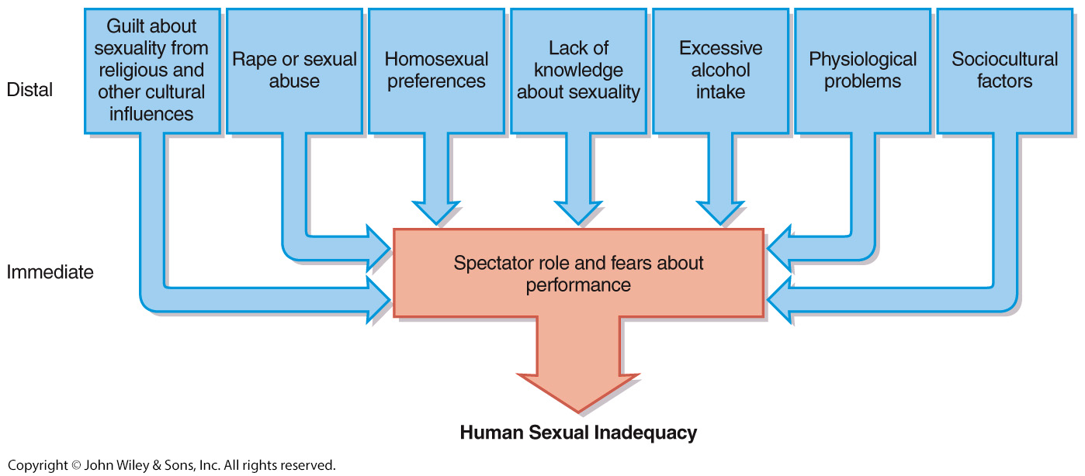
Distal and Immediate Causes of Human Sexual Inadequacies

Slide 26
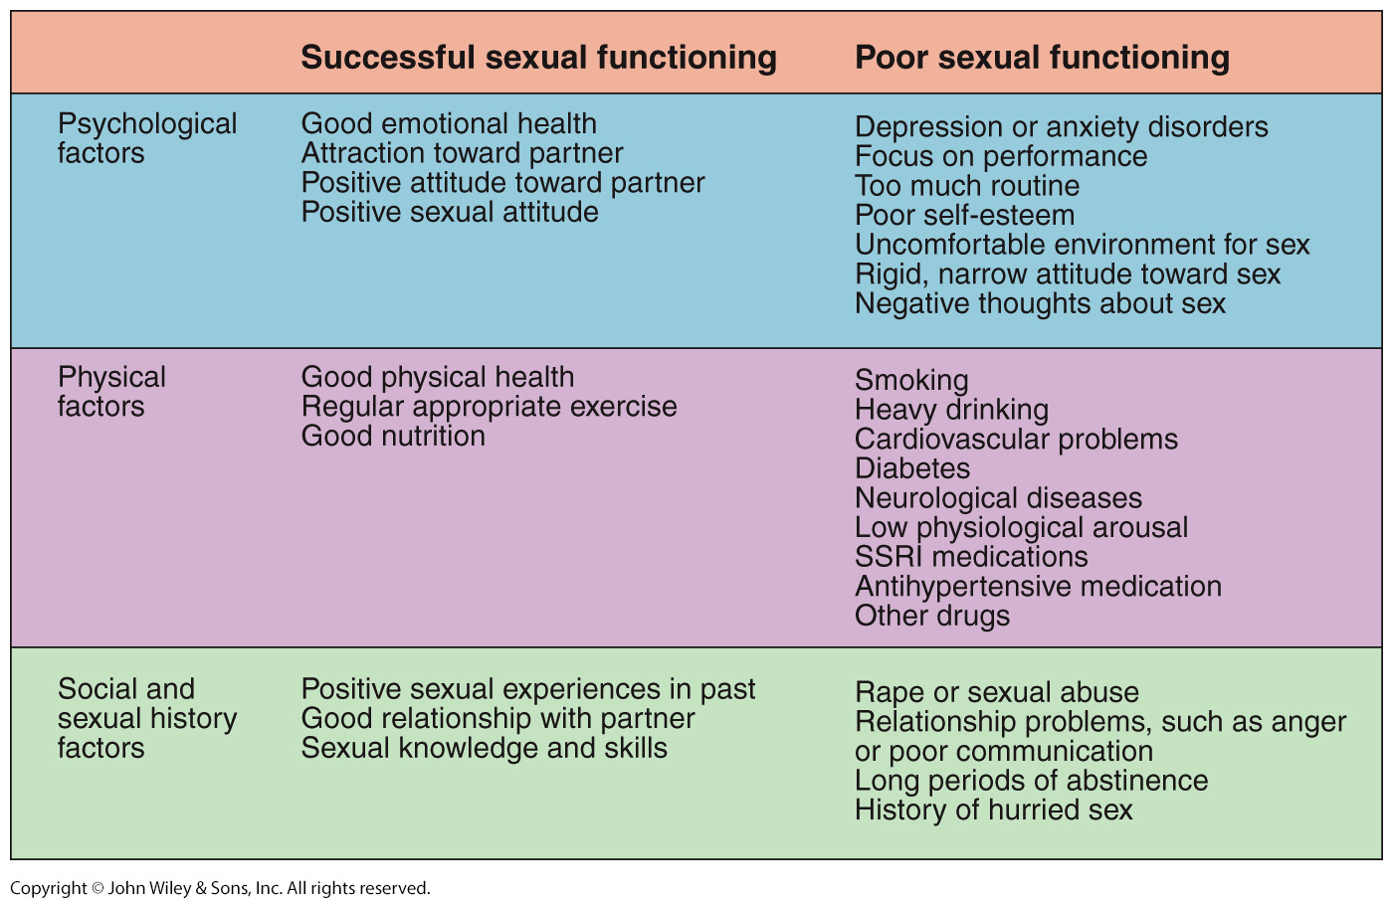
Predictors of Sexual Functioning

Slide 27
Etiology of Sexual Dysfunction: Biological Factors
The DSM-5 includes separate diagnoses for sexual dysfunctions that are caused by medical illnesses
Somewhat controversial because many sexual dysfunctions have a biological contribution
Diseases of vascular system
Diseases of the nervous system
Low levels of testosterone or estrogen

Slide 28
Etiology of Sexual Dysfunction: Biological Factors Cont’d…
Heavy alcohol consumption before sex
History of chronic alcoholism
Heavy cigarette smoking
Medications
Antihypertensives
SSRIs

Slide 29
Etiology of Sexual Dysfunction: Psychosocial Factors
Rape
Early childhood sexual abuse
Relationship problems
Anger, hostility, poor communication
Underlying anxiety about relationship security
Psychological disorders
Major depression, anxiety, or panic disorder
Low physiological arousal
Stress and exhaustion
Negative cognitions

Slide 30
Treatments of Sexual Dysfunction
Anxiety reduction
Directed masturbation
Procedures to change thoughts and attitudes
Sensory awareness procedures
Rational-emotive therapy
Sexual skills and communication training

Slide 31
Treatments of Sexual Dysfunction Cont’d…
Couples therapy
Medications and physical treatments
Squeeze technique for early ejaculation
PDE-5 inhibitors for erectile dysfunction
Phosphodiesterase type 5 inhibitors: sildenafil (Viagra), tadafil (Cialis) and vardenafil (Levitra)
>>>

Slide 32
The Paraphilias
Recurrent sexual attraction to unusual objects or sexual activities for at least 6 months
Deviation (para) in what the person is attracted to (philia)
Should only be diagnosed when they cause marked distress or are done with nonconsenting persons
Transvestic behaviors (cross-dressing for sexual gratification) rarely marked by distress or involves nonconsenting persons

Slide 33
The Paraphilias Cont’d…
Divided categories based on source of arousal:
Sexual attractions based on inanimate objects
Sexual attractions based on children

Slide 34
Paraphilias Included in DSM-5
DSM-5 Diagnosis | Object of Sexual Attraction
Fetishistic disorder | An inanimate object
Transvestic disorder | Cross-dressing
Pedohebephilic disorder | prepubescent and pubescent child
Voyeuristic disorder | Watching unsuspecting others undress or have sex
Exhibitionistic disorder | Exposing one’s genitals to an unwilling stranger
Frotteuristic disorder | Sexual touching of an unsuspecting person
Sexual sadism disorder | Inflicting pain on another to get sexual excitement
Sexual masochism disorder | Getting sexual excitement by receiving pain or being humiliated

Slide 35
Fetishistic Disorder
Diagnostic criteria
For at least 6 months, recurrent and intense sexually arousing fantasies, urges, or behaviors involving the use of nonliving objects or nongenital body parts.
e.g., shoes, stockings, underwear, rubber garments, hair, feet, etc.
The sexually arousing objects are not limited to articles used in cross-dressing or to devises designed to provide tactile genital stimulations, such as a vibrator
Prevalence
Occurs most often in men
Object often necessary for sexual arousal
Attraction to object irresistible and involuntary
Fetishes often co-occur with other paraphilias

Slide 36
Pedohebephilic Disorder and Incest
Pedohebephilic disorder
Pedos = “child”, hebe = “pubescence”, philia = “attraction”
Diagnostic criteria:
Sexually arousing urges, fantasies or behaviors involving sexual contact with a prepubertal or pubescent child
Offender at least 16 years old and 5 years older than victim
Child pornography is widely used
Person has acted on urges or the urges and fantasies cause marked distress or interpersonal problems

Slide 37
Cont’d…
Victims usually known to pedophile
Neighbors, family members, friends, clergy
Most pedophilia does not involve violence other than the sexual activity

Slide 38
Incest
Subtype of pedohebephilic disorder
Most common
Brother and sister
Less common but more pathological
Father and daughter
Incest taboo almost culturally universal
Genetically adaptive
Offspring of father-daughter or brother-sister have a greater likelihood of inheriting pairs of recessive genes with possible negative biological effects

Slide 39
Voyeuristic Disorder
Sexually arousing fantasies, urges, or behaviors while observing others who are unclothed or engaging in sexual activity
Almost always men
Excitement comes from knowing the victim is unaware of the voyeur; element of risk important
Seldom results in physical contact
Orgasm achieved by masturbation
Victims unaware that they are being watched

Slide 40
Diagnostic Criteria: Voyeuristic Disorder
For at least 6 months, recurrent and intense sexually arousing fantasies, urges, or behaviors involving the observation of unsuspecting others who are naked, disrobing, or engaged in sexual activity
Person has acted on these urges with a nonconsenting person, or the urges and fantasies cause marked distress or interpersonal problems

Slide 41
Exhibitionistic Disorder
Intense desire to obtain sexual gratification by exposing one’s genitals to unwilling strangers
Victims can be children
Seldom results in physical contact
Usually involves desire to shock or alarm victim
Often comorbid with voyeuristic and frotteuristic disorders

Slide 42
Diagnostic Criteria: Exhibitionistic Disorder
For at least 6 months, recurrent, intense, and sexually arousing fantasies, urges, or behaviors involving showing one’s genitals to an unsuspecting person
Person has acted on these urges to a nonconsenting person, or the urges and fantasies cause clinically significant distress or interpersonal problems

Slide 43
Frotteuristic Disorder
Sexually oriented touching of a nonconsenting person
The individual rubs his genitals against a women’s body or fondles her breast or genitals
Often occurs in crowded subway or other public place

Slide 44
Sexual Sadism and Sexual Masochism Disorders
Sexual sadism disorder
Intense and recurrent desire to obtain or increase sexual gratification by inflicting pain or psychological suffering on another person
Must cause clinically significant distress or the person has acted on these urges with a nonconsenting person

Slide 45
Cont’d…
Sexual masochism disorder
Intense and recurrent desire to obtain or increase sexual gratification through receiving pain or humiliation
Must cause marked distress or impairment in functioning
Asphyxiophilia
Sexual arousal by oxygen deprivation
Can result in death or serious brain damage
Debate over inclusion in DSM-5

Slide 46
Etiology of the Paraphilias
Neurobiological factors
Male hormones or androgens
Almost all individuals with paraphilias are men
Do not have unusual levels of testosterone
Classical conditioning
Research has not supported orgasm conditioning hypothesis

Slide 47
Etiology of the Paraphilias Cont’d…
Operant conditioning
Poor social skills or reinforcement of unconventionality
History of childhood physical and sexual abuse
Alcohol and negative affect are common triggers
Cognitive distortions
“Because the child doesn’t run away, she must want me to fondle her”

Slide 48
Treatment for Paraphilias
Incarceration and court-ordered treatment are common
Often difficult to interpret outcome from treatment studies
Studies vary greatly
Many lack control groups
Dropout rates high

Slide 49
Treatment of Paraphilias Cont’d…
Enhance motivation
Denial and minimization of problem often present
Some blame the victim
Lack of motivation for treatment
Drop out of treatment

Slide 50
Treatment of Paraphilias Cont’d…
Cognitive behavioral treatment
Aversion therapy
Covert sensitization
Counter distorted thinking
Often combined with social skills and empathy training

Slide 51
Treatment of Paraphilias Cont’d…
Biological treatments
Castration used in past
Medications
Hormonal agents to reduce androgens
Depo-Provera
SSRIs
>>>

Slide 52
THANK YOU

